Slide 1



Slide 2
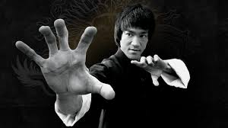
Notes:
We turn this…

Slide 3
Bruce Lee
Notes:
We turn this…

Slide 4
Bruce Lee
On Programming
Notes:
We turn this…

Slide 5
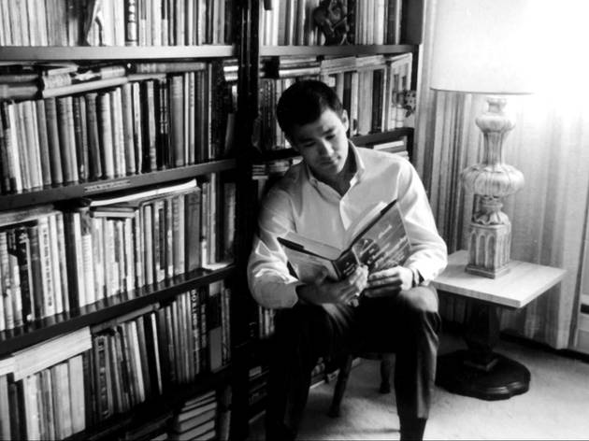
“Time means a lot to me because you see I am also a learner and am often lost in the joy of forever developing.”
“After all, all knowledge simply means self-knowledge.”
Notes:
We turn this…

Slide 6
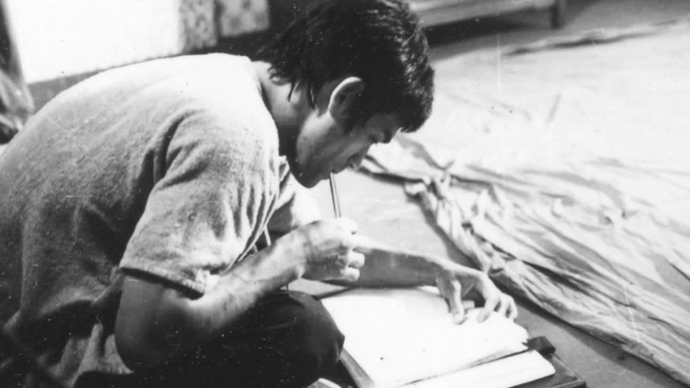
“Time means a lot to me because you see I am also a learner and am often lost in the joy of forever developing.”
“After all, all knowledge simply means self-knowledge.”
“Life itself is your teacher, and you are in a state of constant learning.”
“Learning is never cumulative, it is a movement of knowing which has no beginning and no end.”
Notes:
Even though it was the early 70s when he learned to program,
from his writings you can really see he grasped the essence of programming in a timeless way, that still rings true today.

Slide 7
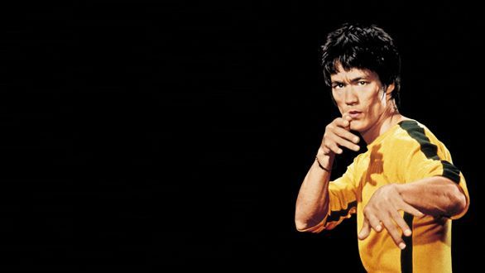
On Coding
Notes:
How do we _know_ he learned how to code? This quote makes it obvious that he did.

Slide 8
On Coding
“It’s not the daily increase but daily decrease.
Hack away at the unessential.”‎
Notes:
How do we _know_ he learned how to code? This quote makes it obvious that he did.
This is where the term “hacking” originates.

Slide 9
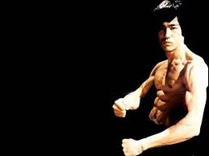
On Refactoring
"Adapt what is useful, reject what is useless, and add what is specifically your own.”
“Use only that which works, and take it from any place you can find it.”
Notes:
We turn this…

Slide 10
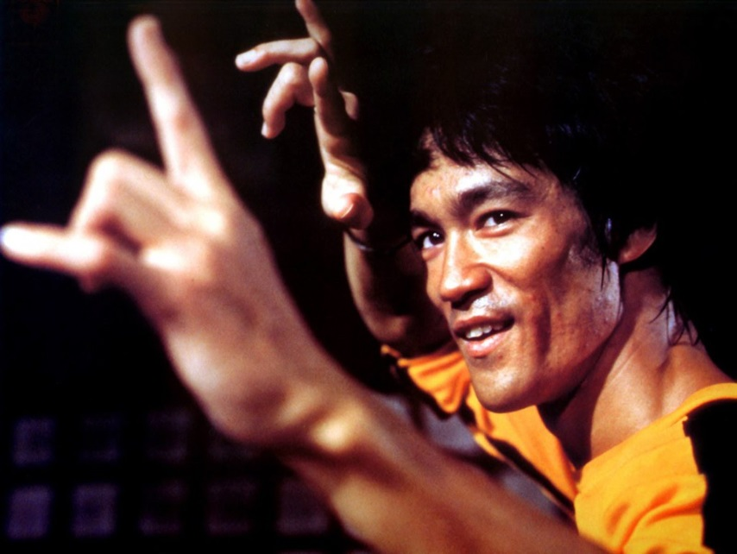
On Prototyping
“If you want to learn to swim jump into the water. On dry land no frame of mind is ever going to help you.”
Notes:
We turn this…

Slide 11
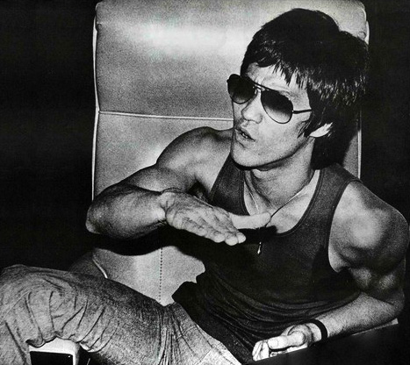
On Being in the Zone
“Everything you do, if not in a relaxed state will be done at a lesser level than you are proficient.”
Notes:
We turn this…

Slide 12
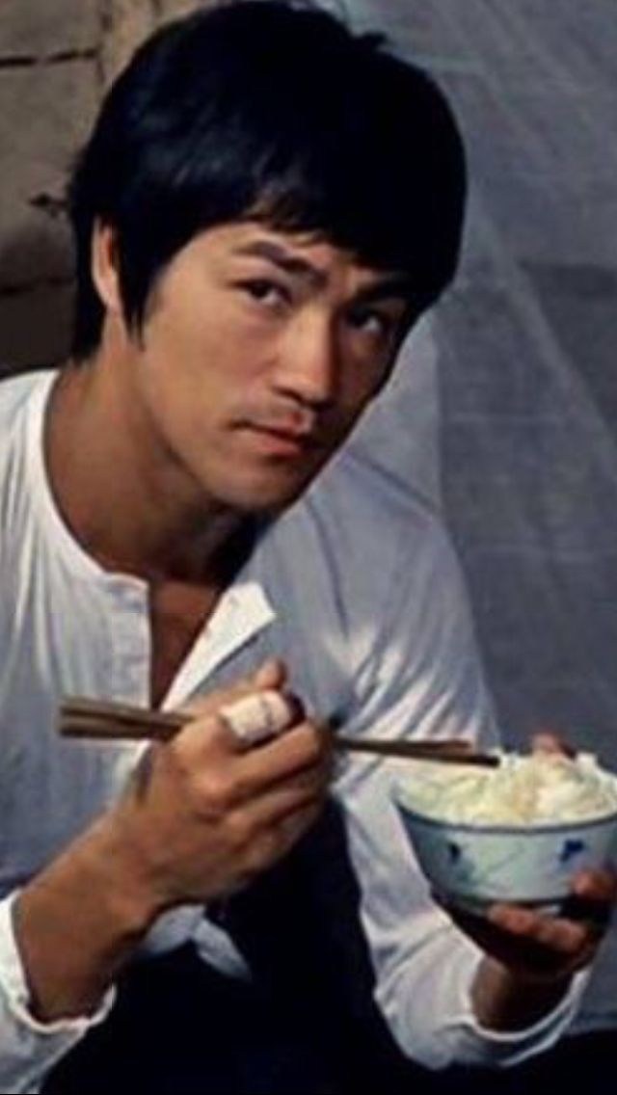
On Object Oriented Programming
Notes:
We turn this…

Slide 13
On Object Oriented Programming
“The more we value things, the less we value ourselves.”
Notes:
We turn this…

Slide 14
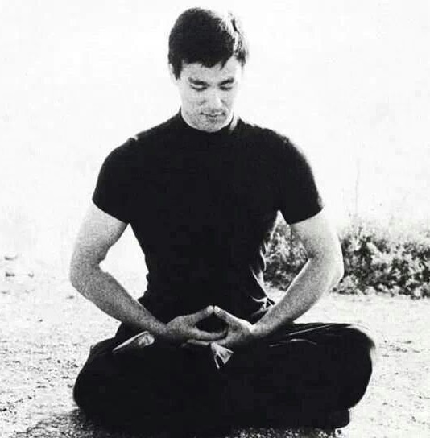
On Design Patterns
“All fixed set patterns are incapable
of adaptability or pliability.
The truth is outside of all fixed patterns.”
Notes:
We turn this…

Slide 15
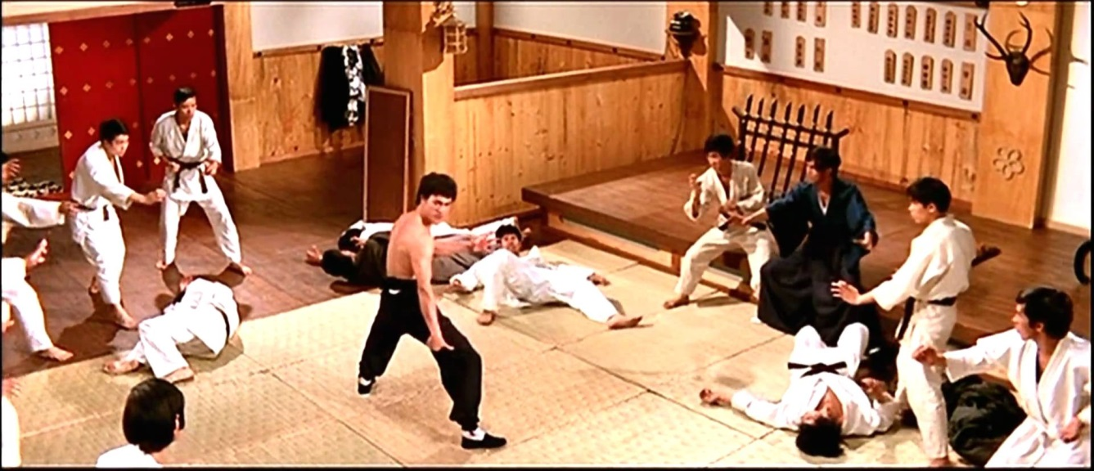
“I try to live freely from moment to moment, letting things happen and adjusting to them.”
On Agile
Notes:
We turn this…

Slide 16
From Jackie Kay:
"I fear not the developer who has written 10,000 libraries, but the developer who has rewritten one library 10,000 times."
Notes:
We turn this…

Slide 17
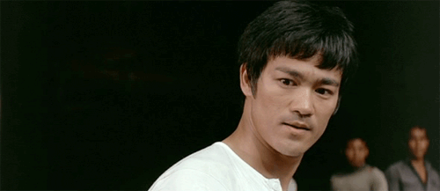
From Jackie Kay:
"I fear not the developer who has written 10,000 libraries, but the developer who has rewritten one library 10,000 times."
Notes:
We turn this…

Slide 18
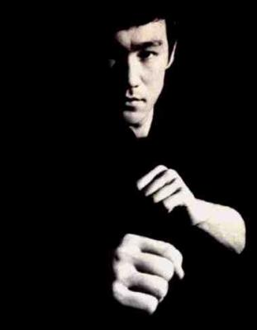
On Ownership Semantics
“The possession of anything begins in the mind.”
Notes:
We turn this…

Slide 19
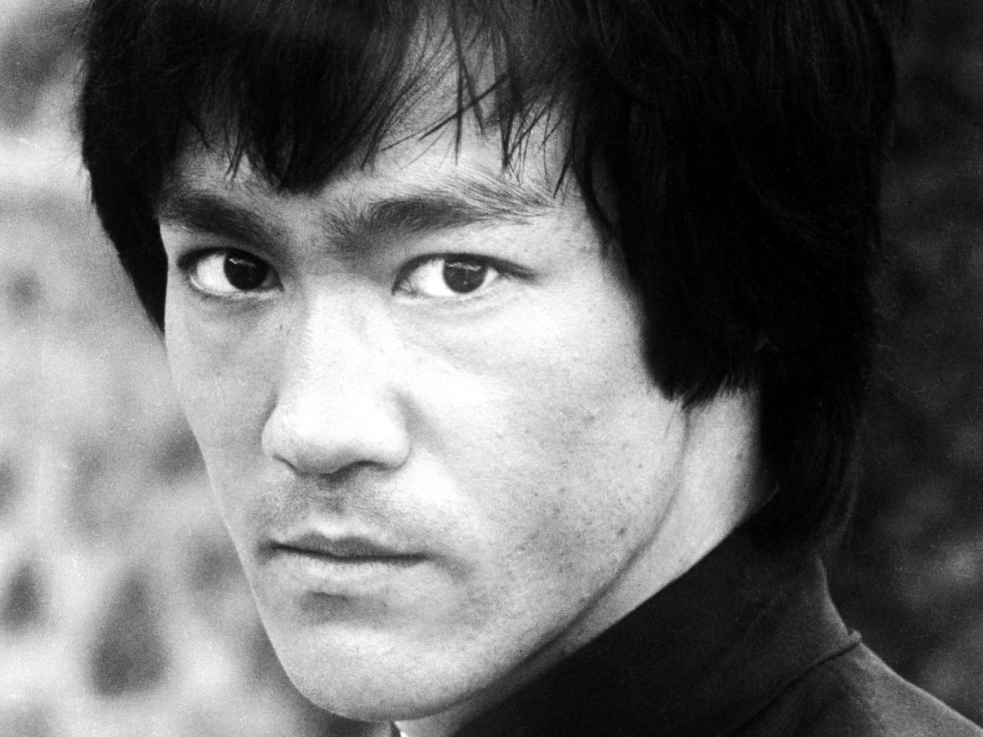
On Bounds Checking
“Life is wide, limitless. There is no border, no frontier.”
Notes:
We turn this…

Slide 20
On Bounds Checking
“Life is wide, limitless. There is no border, no frontier.”
REALLY???
Notes:
Do you really not do bounds checking?

Slide 21
On Bounds Checking
“Life is wide, limitless. There is no border, no frontier.”
“There are no limits. There are plateaus, but you must not stay there, you must go beyond them. If it kills you, it kills you. A man must constantly exceed his level.”
Notes:
Let the program crash!

Slide 22
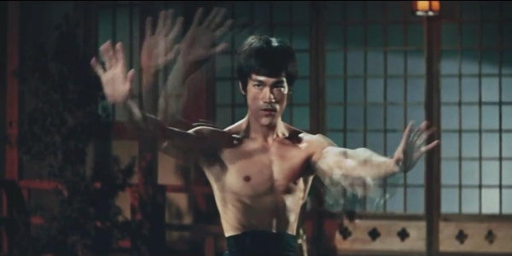
Notes:
We turn this…

Slide 23
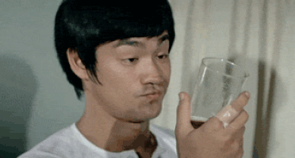
On the difficulties with std::variant
Notes:
We turn this…

Slide 24
On the difficulties with std::variant
“In order to taste my cup of water
you must first empty your cup.”
Notes:
We turn this…

Slide 25
On Regular Void
Notes:
We turn this…

Slide 26
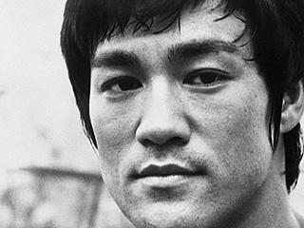
On Regular Void
“Empty your cup so that it may be filled; become devoid to gain totality.”
Notes:
We turn this…

Slide 27
On being part of the C++ Committee
Notes:
We turn this…

Slide 28
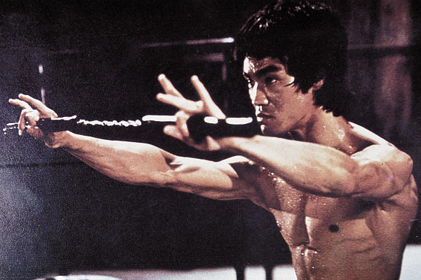
On being part of the C++ Committee
“Take no thought of who is right or wrong or who is better than. Be not for or against.”
Notes:
We turn this…

Slide 29
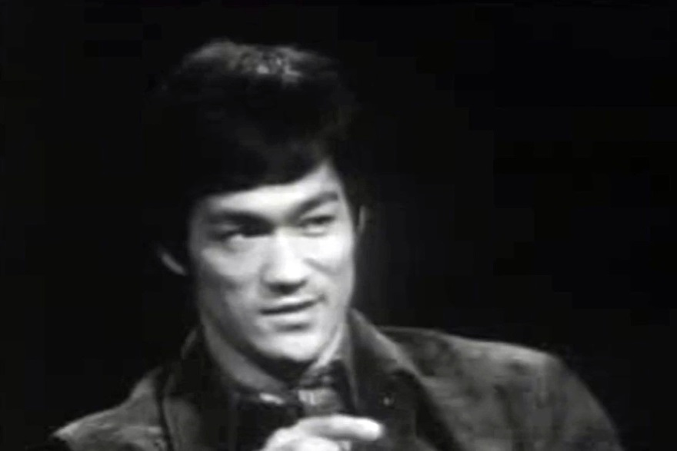
On Move Semantics
Notes:
We turn this…

Slide 30
On Move Semantics
“The stillness in stillness is not the real stillness; only when there is stillness in movement does the universal rhythm manifest.”
Notes:
We turn this…

Slide 31
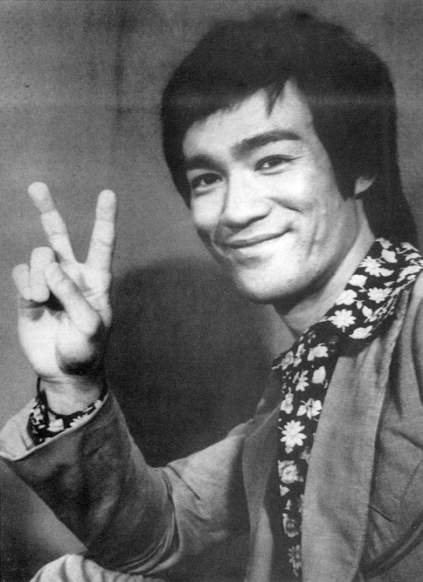
On default comparisons
“Reality is apparent when one ceases to compare. —
There is “what is” only when there is no comparison at all,
and to live with what is, is to be peaceful.”
Notes:
We turn this…

Slide 32
On C++ Core Guidelines
Notes:
Write simple code – that lets the compiler do the work

Slide 33
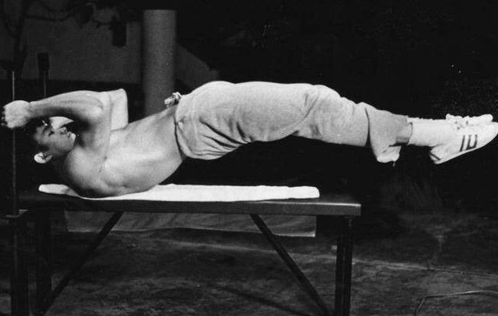
On C++ Core Guidelines
“Obey the principles without being bound by them.”
Notes:
Write simple code – that lets the compiler do the work

Slide 34
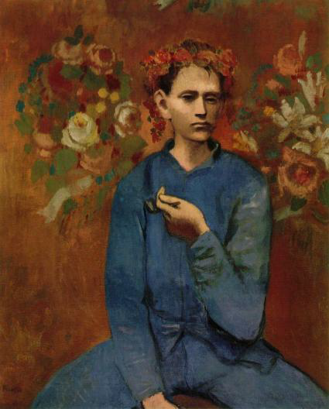
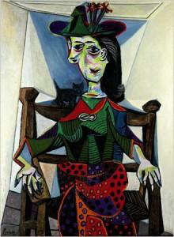
On C++ Core Guidelines
1905
1941
“Learn the rules like a pro, so you can break them like an artist.”
-- Pablo Picasso
Notes:
Write simple code – that lets the compiler do the work

Slide 35
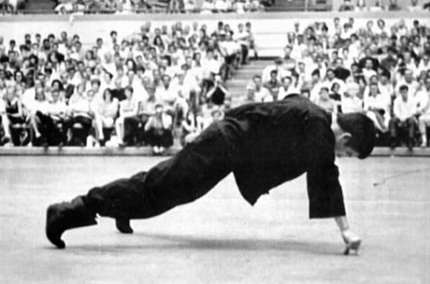
On Efficiency & Optimization
“To me, the extraordinary aspect of coding arts lies in its simplicity. The easy way is also the right way, and coding arts is nothing at all special; the closer to the true way of coding arts, the less wastage of expression there is.”‎
Notes:
Write simple code – that lets the compiler do the work

Slide 36
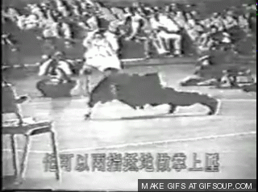
On Efficiency & Optimization
“The less effort, the faster and more powerful you will be.”
Notes:
Write simple code – that lets the compiler do the work

Slide 37
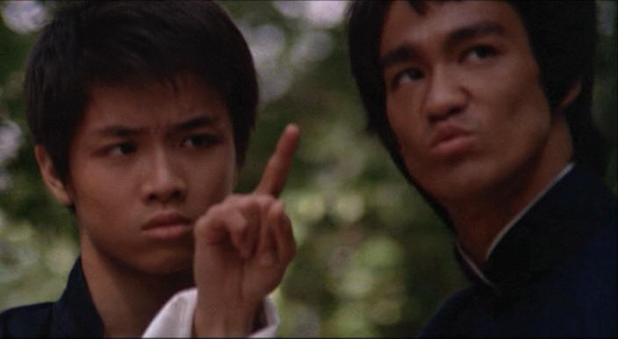
“A goal is not always meant to be reached,
it often serves simply as something to aim at.”
Notes:
We turn this…

Slide 38
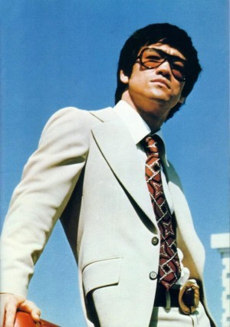
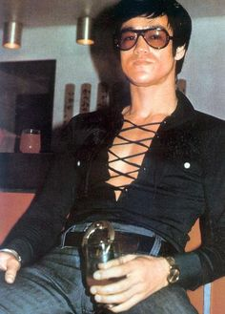
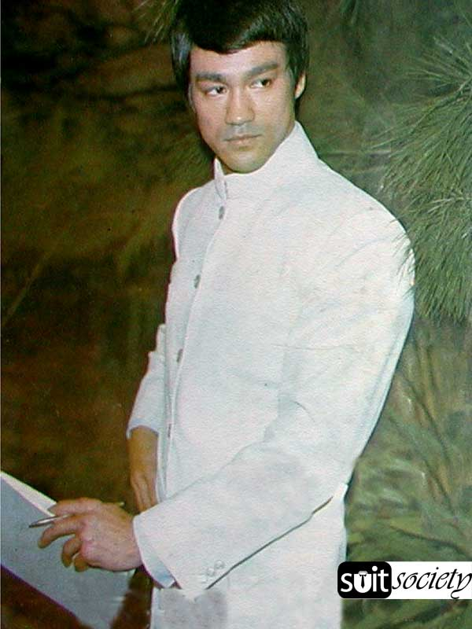
On Coding Style
“When one has no form, one can be all forms;
when one has no style, he can fit in with any style.‎”
Notes:
We turn this…

Slide 39
On getters and setters
Notes:
We turn this…

Slide 40
On getters and setters
“It’s not what you give, it’s the way you give it.
Notes:
We turn this…

Slide 41
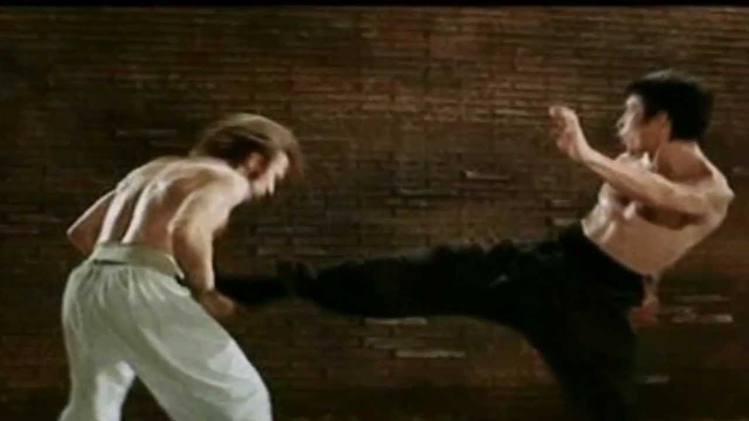
On getters and setters
“It’s not what you give, it’s the way you give it.
Notes:
We turn this…

Slide 42
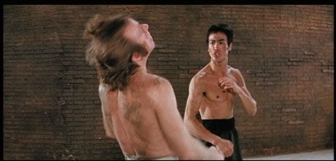
On getters and setters
“It’s not what you give, it’s the way you give it.
Notes:
We turn this…

Slide 43
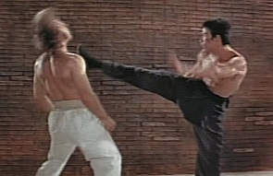
On getters and setters
“It’s not what you give, it’s the way you give it.
Notes:
We turn this…

Slide 44
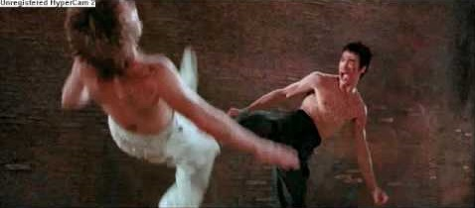
On getters and setters
“It’s not what you give, it’s the way you give it.
Notes:
We turn this…

Slide 45
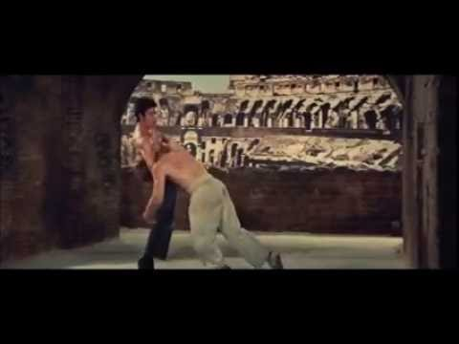
On getters and setters
“It’s not what you give, it’s the way you give it.
Notes:
We turn this…

Slide 46
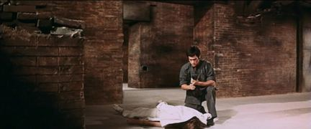
On getters and setters
“It’s not what you give, it’s the way you give it.
Notes:
We turn this…

Slide 47
On getters and setters
“It’s not what you give, it’s the way you give it.
Notes:
We turn this…

Slide 48
On getters and setters
“It’s not what you give, it’s the way you give it.
Notes:
We turn this…

Slide 49
On getters and setters
“It’s not what you give, it’s the way you give it.
Notes:
We turn this…

Slide 50
On getters and setters
“It’s not what you give, it’s the way you give it.
Notes:
We turn this…

Slide 51
On getters and setters
“It’s not what you give, it’s the way you give it.
Notes:
We turn this…

Slide 52
On getters and setters
“It’s not what you give, it’s the way you give it.
Notes:
We turn this…

Slide 53
On Other Languages
Notes:
We turn this…

Slide 54
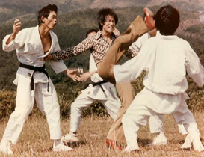
On Other Languages
“Do not deny the classical approach, simply as a reaction, or you will have created another pattern and trapped yourself there.”
Notes:
We turn this…

Slide 55
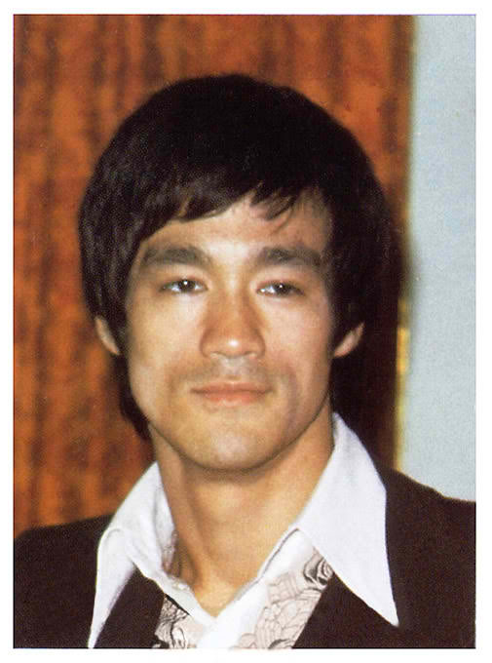
“As you think, so shall you become.”
- Bruce Lee
Notes:
We turn this…

Slide 56
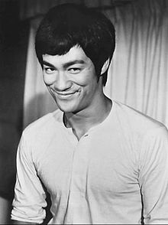
“Be like int.”
Notes:
We turn this…

Slide 57
Notes:
We turn this…

Slide 58
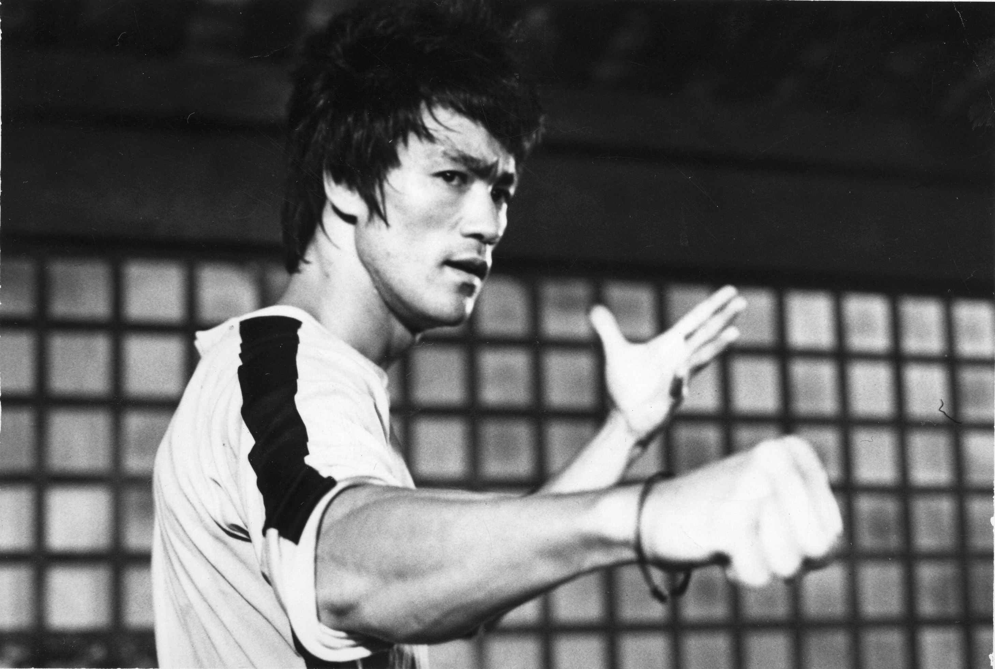
On
“.”
Notes:
We turn this…

Slide 59
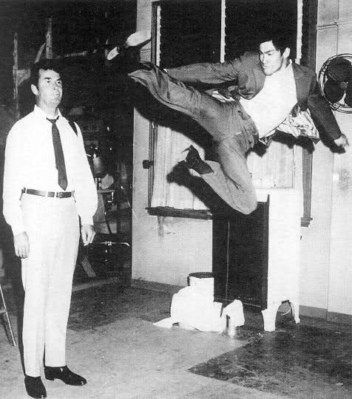
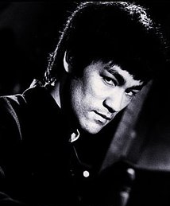
On
“.”
Notes:
We turn this…

Slide 60
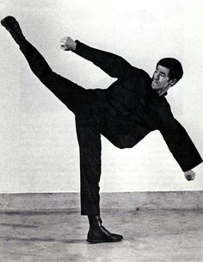
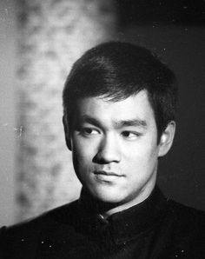
On
“.”
Notes:
We turn this…

Slide 61
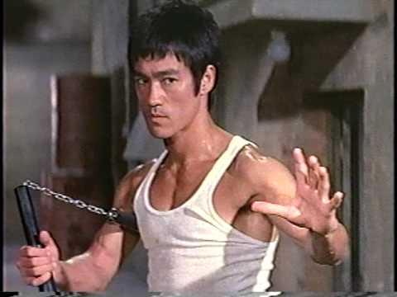
On
“.”
Notes:
We turn this…

Slide 62
On Mentoring
“A good teacher protects his pupils from his own influence.”
Notes:
We turn this…

Slide 63
“The word “superstar” is an illusion”

